Slide 1
Fragmentation & Segmentation
Arslan Ali - 01-243211-002
Shahid Hussain – 01-243211-009

Slide 2
Fragmentation
Fragmentation is an unwanted problem in the operating system in which the processes are loaded and unloaded from memory, and free memory space is fragmented. Processes can't be assigned to memory blocks due to their small size, and the memory blocks stay unused.

Slide 3
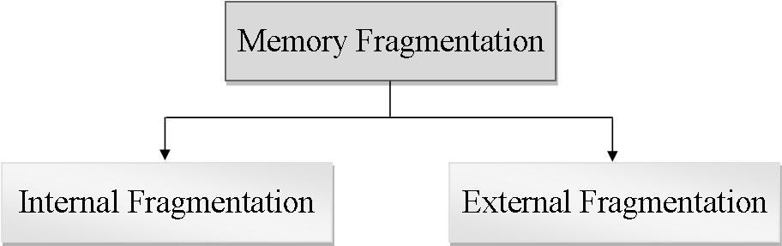
Types

Slide 4
Internal Fragmentation
When a process is allocated to a memory block, and if the process is smaller than the amount of memory requested, a free space is created in the given memory block. Due to this, the free space of the memory block is unused, which causes internal fragmentation.

Slide 5
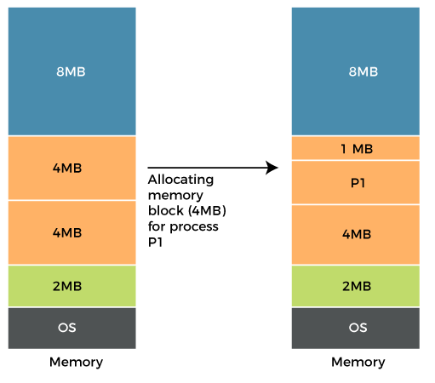
Example
Allocation of Ram using fixed partitioning
2MB, 4MB, 4MB, and 8MB are the available sizes
A process P1 with a size of 3MB arrives
Memory block of 4MB available
As a result, the 1MB of free space in this block is unused

Slide 6
How to avoid internal fragmentation
Internal fragmentation may arise due to the fixed sizes of the memory blocks
Internal fragmentation can be decreased by effectively allocating the littlest partition
It can be solved using dynamic partitioning

Slide 7
External Fragmentation
External fragmentation happens when a dynamic memory allocation method allocates some memory but leaves a small amount of memory unusable. The quantity of available memory is substantially reduced if there is too much external fragmentation. There is enough memory space to complete a request, but it is not contiguous. It's known as external fragmentation

Slide 8
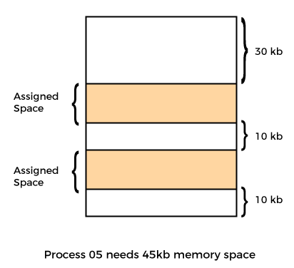
Example
Allocation of Ram using dynamic partitioning
Memory allocated according to size of process
A process P5 with a size of 45kb arrives
50 kb memory available
Cannot assign memory due to non-contiguous memory

Slide 9
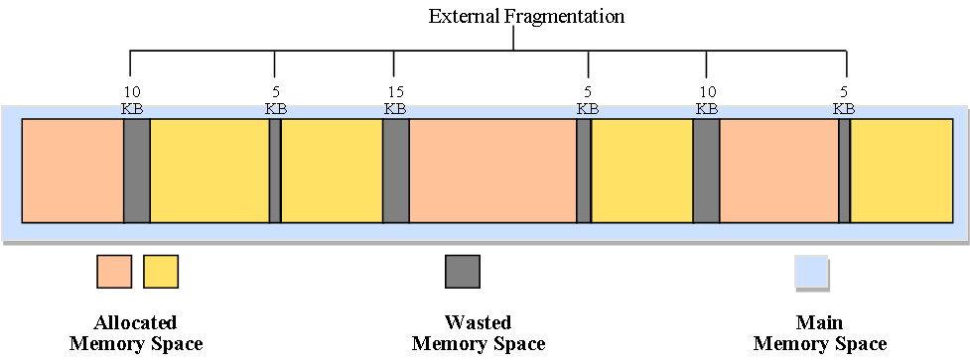
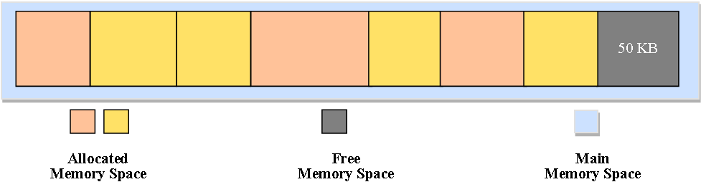
How to Avoid External fragmentation
Compaction
when dynamic partitioning is used for memory allocation by combining all free memory into a single large block

Slide 10
Comparison B/W Internal & External Fragmentation
 | Internal Fragmentation | External Fragmentation
Memory block size | It occurs when allocated memory block are of fixed size. | It occurs when the allocated memory blocks are of different sizes.
Occurrence | It occurs when a process requires more space or uses less space than the size of an allocated memory block. | It occurs when a process is removed from main memory.
Solution | Best fit block search is the solution for internal fragmentation. | Compaction is the solution for external fragmentation.

Slide 11
Segmentation

Slide 12
Segmentation
Segmentation is a memory management technique
Memory is divided into the variable size parts
Each part is known as a segment allocated to a process
Segment table

Slide 13
Cont…
Segment Table
Base
base address of the segment.
Limit
length of the segment.

Slide 14
Why Segmentation is required?

Slide 15
Segmentation
Logical address
Main program
Function
Object
Local and global variable
Stack
Symbol table
Arrays

Slide 16
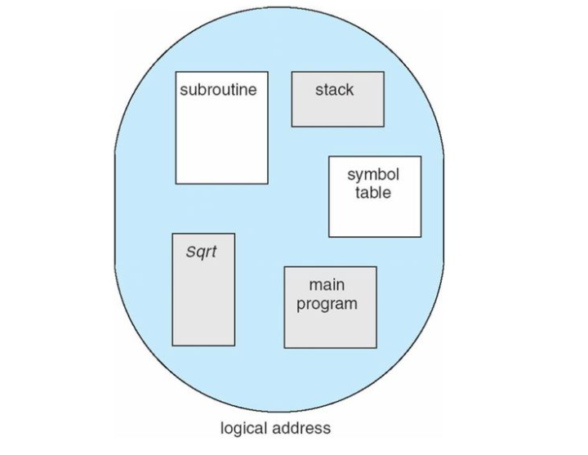
User’s view of program

Slide 17
Translation of logical address into physical address by segment table
CPU generates a logical address
Segment Number
Offset

Slide 18
Example of segmentation
CPU
S0
S3
S2
S4
S1
1400
S no | Base | Limit
0 | 1400 | 1000
1 | 6300 | 400
2 | 4300 | 400
3 | 3200 | 1100
4 | 4700 | 1000
2400
<=
3200
YES
+
s d
4200
4700
5700
No
6300
Trap
6700
Segment Table
Physical Memory

Slide 19
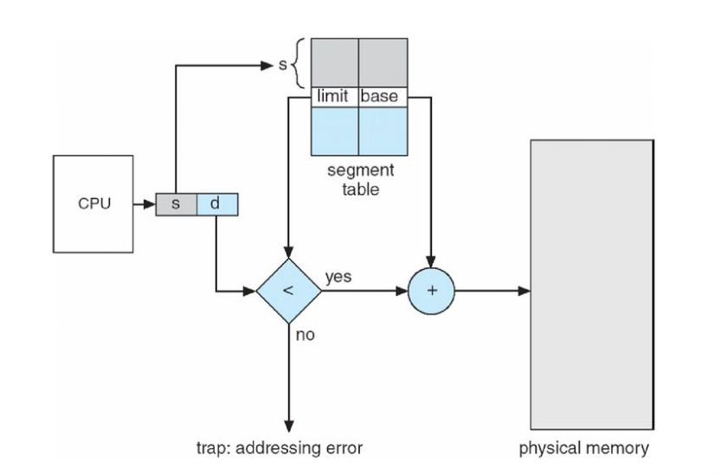
Segmentation Hardware

Slide 20
Thank You

